Slide 1
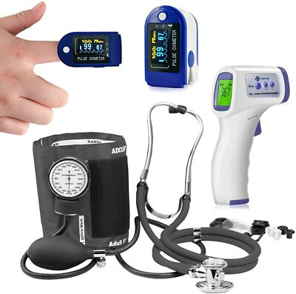
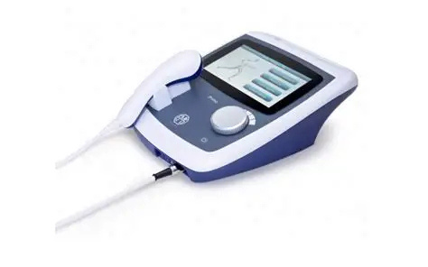
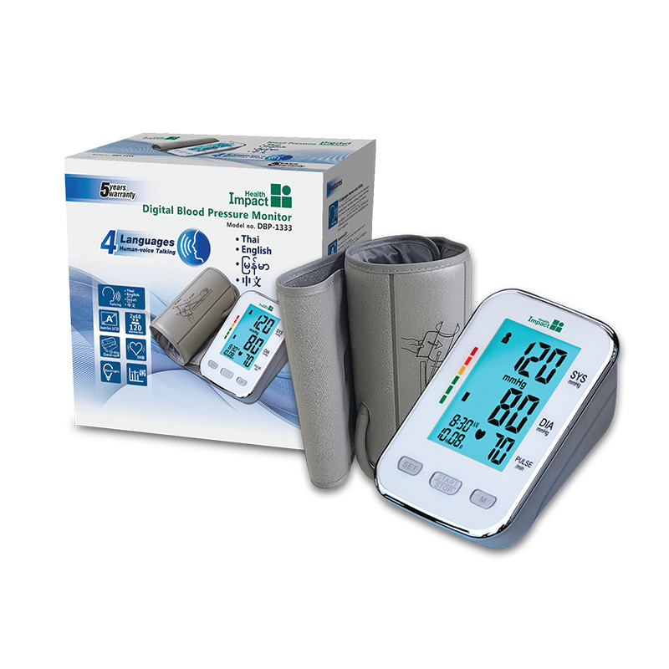
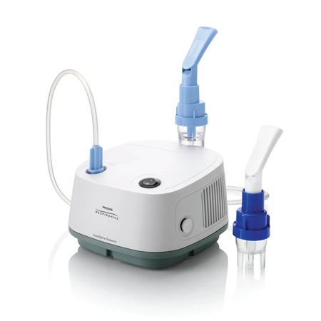
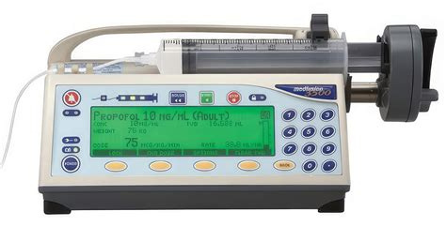
IEC standards - IEC 60601
Safety Class II
presented by:
210169L – W.W.R.N.S. Fernando

Slide 2
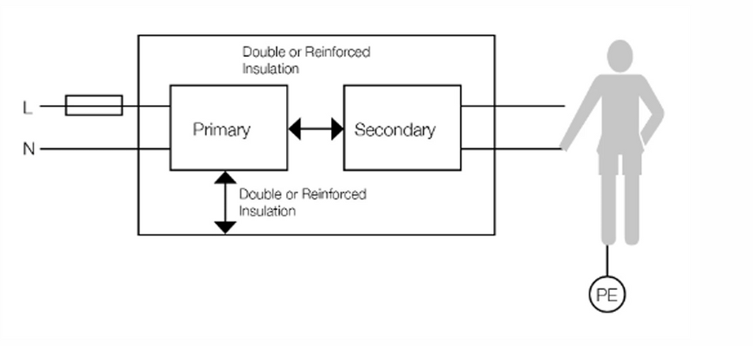
Definition of
Class II Equipment
“Electrical equipment in which protection against electric shock does not rely on basic insulation only; additional precautions such as double or reinforced insulation are provided, with no provision for protective earthing.”
Key idea:
Safety is achieved through insulation integrity, not earthing.

Slide 3
Concept of Double Insulation
and Reinforced Insulation
Basic insulation: Primary barrier between live conductors and accessible parts. Prevents electric shock in normal operating conditions. | Supplementary insulation: Independent second barrier added in case the basic insulation fails. Maintains safety under single-fault condition.
Double Insulation Combination of basic + supplementary insulation. Provides two Means of Protection (MOP) against electric shock. Common in plastic-housed portable devices (e.g., monitors, pumps). | Reinforced Insulation A single insulation system designed and tested to provide the same protection as double insulation. Saves space while offering two MOP in one layer (used in transformers, cables, PCB layouts).
Safety Outcome
Even if one barrier breaks down, current cannot reach the patient or metal enclosure.Ensures continuous protection in both normal and fault conditions.
Notes:
🔹 Definition
A Means of Protection (MOP) is any safety measure that prevents electric shock to a person (patient or operator) when using medical electrical equipment.
It can be achieved through insulation, spacing, earthing, or impedance limits.
IEC 60601-1 defines two types:
MOOP → Means of Operator Protection
→ Protects doctors, nurses, or technicians handling the equipment.
MOPP → Means of Patient Protection
→ Protects patients — who are much more vulnerable to small currents.

Slide 4





Construction Features of Class II Equipment
No Protective-Earth Conductor
Double / Reinforced Insulation
  Class II equipment does not rely on an earth connection for safety.
  The design ensures protection through insulation barriers instead.
  All accessible conductive parts are completely isolated from live circuits.
  Even under a single-fault condition, the user or patient cannot touch a live surface.
Creepage & Clearance
  Both must comply with IEC 60601-1 Tables 7–12, ensuring adequate spacing to prevent arcing or tracking.
Design Integrity
Enclosure Material
  Layouts and materials selected to maintain insulation over device lifetime. resisting heat, humidity, and mechanical stress.
  Plastic or composite housings are preferred. lightweight, durable, and inherently insulating.
  If metal chassis is used, it must be fully encapsulated or double-insulated to prevent accidental contact.
Notes:
“Now let’s look at how Class II devices are physically constructed to achieve their safety.
First, unlike Class I equipment, these devices don’t have a protective-earth conductor. All protection depends on the integrity of their insulation barriers.
Every conductive surface that a user or patient can touch is separated from live parts by either double or reinforced insulation. This ensures safety even if one insulation layer fails.
To prevent any chance of arcing, the creepage and clearance distances are carefully calculated following IEC 60601-1 tables, depending on voltage and pollution level.
The outer enclosure is typically plastic or a composite material, which naturally provides insulation and reduces weight.
In cases where a metal chassis is needed for strength or heat dissipation, it’s completely encapsulated so there’s no exposed metal connected to live circuits.
Altogether, these construction practices guarantee that Class II devices stay safe and reliable, even in environments where earthing may be unavailable.”
Creepage = surface distance along insulation.
Clearance = air gap between conductive parts.

Slide 5
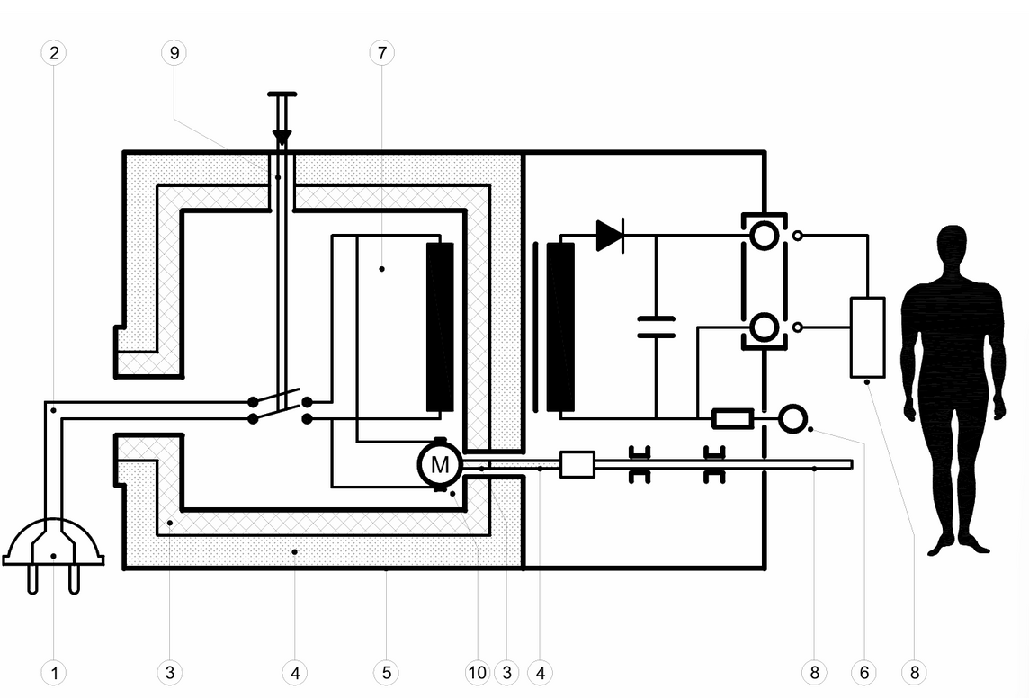
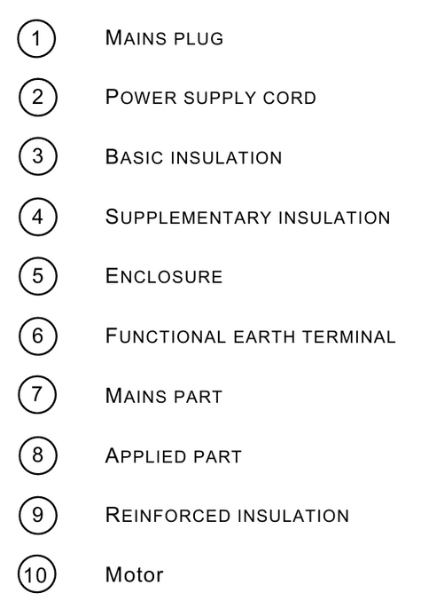
Internal Design Elements of Class II Devices
  Every conductive path from the mains to the patient or operator passes through two independent insulation barriers.
  The functional earth exists only for electromagnetic compatibility, not protection.
  Even in a single-fault condition, no current can reach the patient.
Notes:
“This diagram shows the internal construction of a typical Class II medical electrical device.
Starting from the left, you can see the mains plug and power cord feeding into the device. Notice that there’s no protective-earth conductor—safety is entirely based on insulation.
The blue and cyan layers represent the basic and supplementary insulation, which together form double insulation. Around certain parts, like the motor and applied part, we have reinforced insulation, offering the same level of protection in a single layer.
The entire assembly is enclosed in an insulating housing—marked here as the green line—ensuring that no live components are accessible to the user or patient.
The motor, shown at the bottom, is isolated by reinforced insulation even though it has a metal shaft accessible to the outside.
Altogether, this layout ensures that even if one insulation barrier fails, there’s still another protecting the patient and operator from any electric shock.”

Slide 6

Marking and Identification
The symbol for class II equipment is 2 concentric squares indicating double insulation as shown in the image.
  Must appear on:
    Equipment enclosure
    Rating plate and accompanying documents
  Warns users that no earth connection should be made

Slide 7
Testing Requirements for Class II Equipment
Test | Purpose | Typical Standard / Limit
Dielectric Strength Test | Ensures insulation can safely withstand high voltages between live parts and accessible surfaces. | 4–5 kV AC for 1 minute
Insulation Resistance Test | Checks insulation material quality and verifies no moisture or contamination. | ≥ 50 MΩ at 500 V DC
Leakage Current Test | Confirms that touch and patient currents remain within safe levels during operation. | ≤ 0.1 mA (touch); ≤ 0.01 mA (patient)
Creepage & Clearance Verification | Measures spacing between conductive parts to prevent arcing and tracking. | ≥ 8 mm (mains to accessible parts)
Single Fault Condition Test | Simulates failure of one insulation barrier to confirm continued protection. | No electric shock hazard allowed
Notes:
After design and construction, every Class II medical device must pass several electrical safety tests defined in IEC 60601-1.
The dielectric strength test applies a high voltage — usually around 4 to 5 kilovolts — between live and accessible parts to ensure the insulation won’t break down.
Next, the insulation resistance test verifies that materials are dry and clean; high resistance means the insulation is still effective.
The leakage current test checks that the small currents flowing through insulation or capacitance are far below harmful levels — for patients, that’s typically under 0.01 milliamps.
Then we check creepage and clearance distances on PCBs and internal wiring to make sure there’s enough spacing to prevent arcing, especially under humidity or voltage spikes.
Finally, the single-fault condition test intentionally disables one insulation barrier to confirm that the second layer still protects the user.
Together, these tests verify that Class II devices remain safe throughout their life — even when faults occur.”

